Slide 1
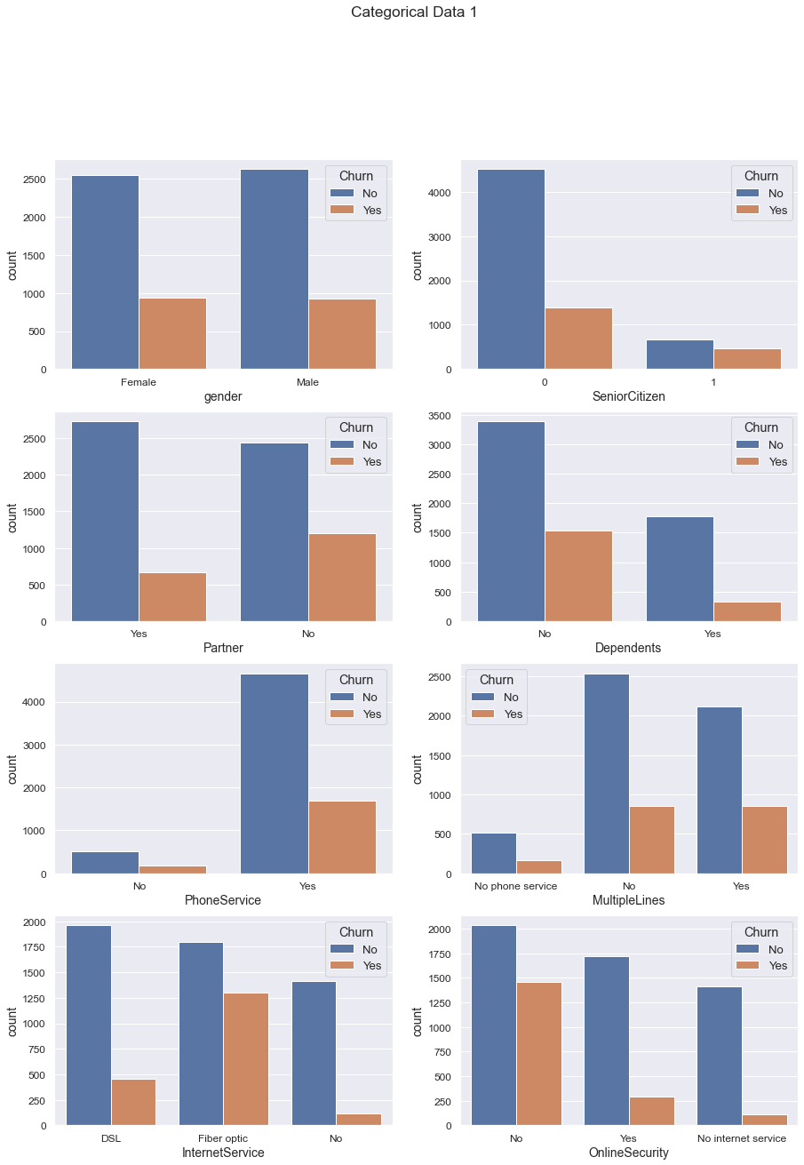

No partner No dependents Has Phone Service Has Fiber Optic No Online Security
FiNDINGS PART 1

Slide 2
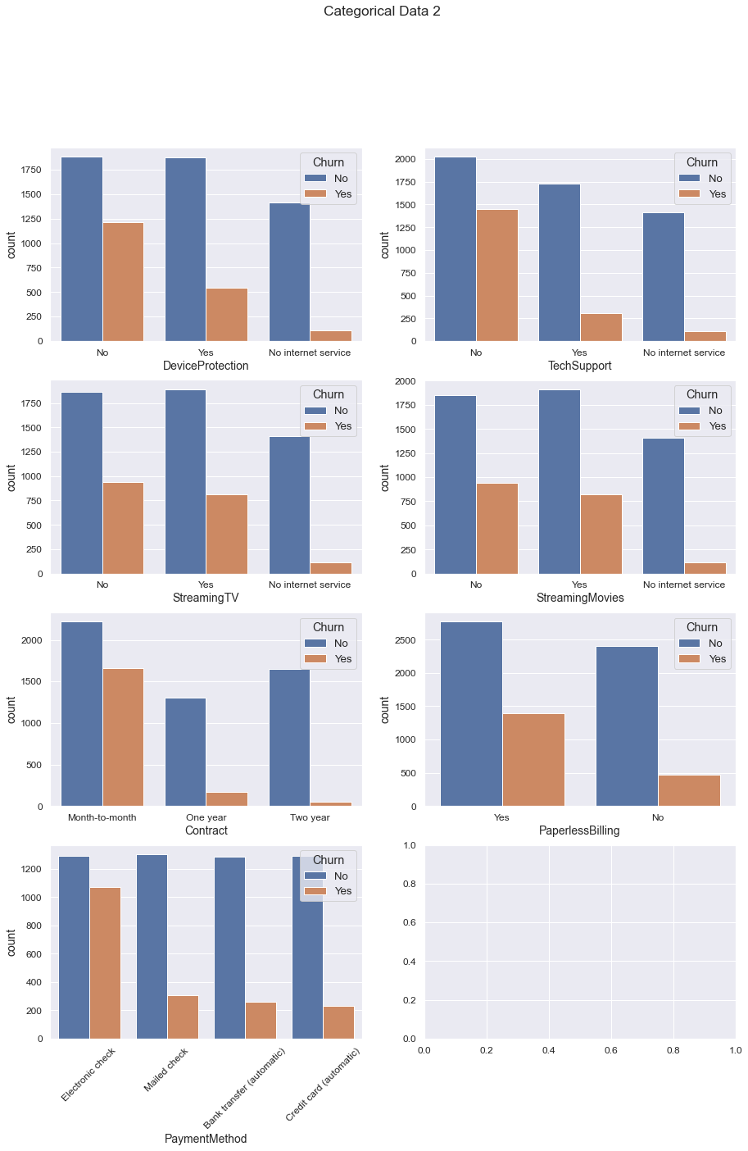
No Device Protection No Tech Support Monthly Contracts Has Paperless Billing Use electronic checks
FiNDINGS PART 2

Slide 3
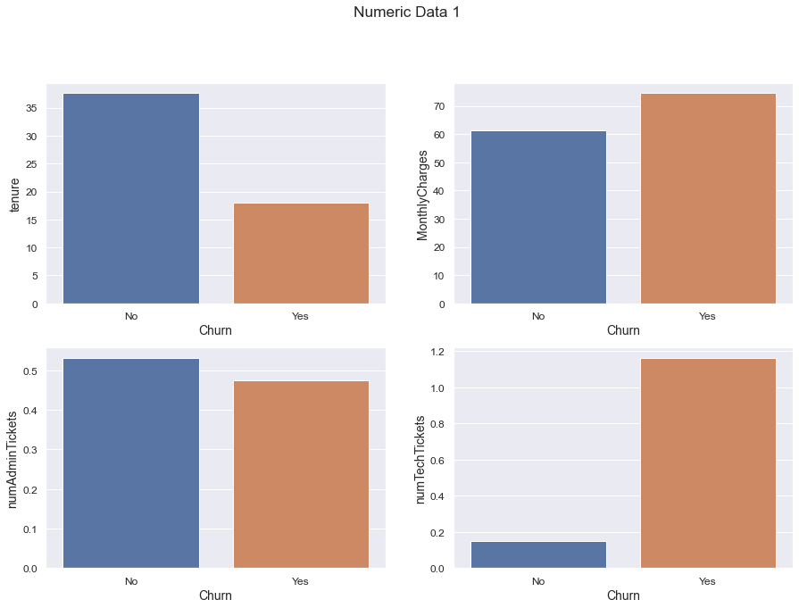
Short Tenure (18 months) Monthly Charges (More than $70) High number of Technical Support tickets
FiNDINGS PART 3

Slide 4
Recommendations
Singles | Bundles | support | pricing
Revise plans | Revisit charges for phone service and optic fiber | Technical support needs improvment | Offer attractive tenures
 | Ease of payment introduced | Offer extra security device and software support | Offer competitive prices

